Slide 1
Vocabulary
Music

Slide 2

Available /əˈveɪləbl/
Adj: ready to use and serve

Slide 3

Broaden /ˈbrɔːdn/
V: make wider

Slide 4
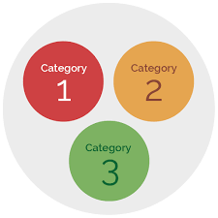
Category /ˈkætəɡəri/
N: Type, a class of a system

Slide 5

Disparate /ˈdɪspərət/
Adj: different
Eg: Religious songs are disparate categories of music

Slide 6
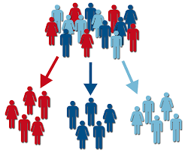
Divide /dɪˈvaɪd/
V: separate into parts, groups
Eg: Teacher divides my class into 4 groups.

Slide 7


Favor /ˈfeɪvə(r)/
V: be partial to, help
Eg: Sam enjoys the works of several composers but he tends to favor Mozart

Slide 8

Instinct /ˈɪnstɪŋkt/
N: inborn pattern as a powerful motivation

Slide 9
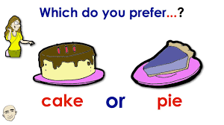
Prefer /prɪˈfɜː(r)/
V: to like sth/ sb more than others
Eg: He prefers pop music to any other types.

Slide 10

Reason /ˈriːzn/
N: the basic motive for sth
Eg: We can’t understand the reason why some music are popular and some aren’t.

Slide 11

Relaxation /ˌriːlækˈseɪʃn/
N: the state of being relaxed
Eg: Listening to pop music before bedtime provides good relaxation.

Slide 12

Taste /teɪst/
N: ability to discern what is excellent
Eg: He has very good taste in fashion.

Slide 13
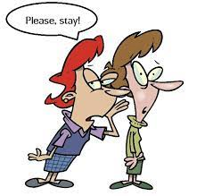
Urge /ɜːdʒ/
V: force sb to do sth

